Slide 1


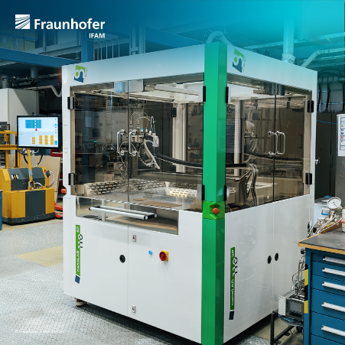

LISPIE
This Democase deals with the development of a scalable and automatable coating process that can be adapted to the different materials systems used for OER and HER.
A new large-scale automated spray coater was used to uniformly deposit catalyst-containing inks or slurries onto substrates to demonstrate the upscaling potential of this particular coating technique. The spray parameters for two newly developed ink formulations were optimised (PGM-free catalysts Al/Raney-like Ni, and Ni-Fe), and tailored heat-treatment procedures for each material system were performed.
starting materials
final electrode
Suspension / Ink
production process
Ni foam
(Alantum)
spray coating
heat treatment of coated foam
Project and process overview
This project has received funding from the European Union’s Horizon Europe research and innovation programme. Views and opinions expressed are however those of the author(s) only and do not necessarily reflect those of the European Union or the European Innovation Council and SMEs Executive Agency (EISMEA). Neither the European Union nor the granting authority can be held responsible for them

Slide 2

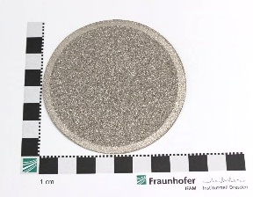
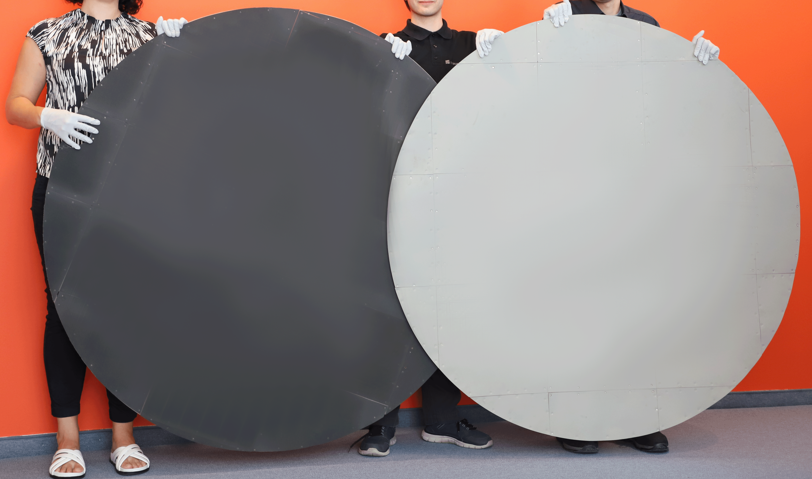
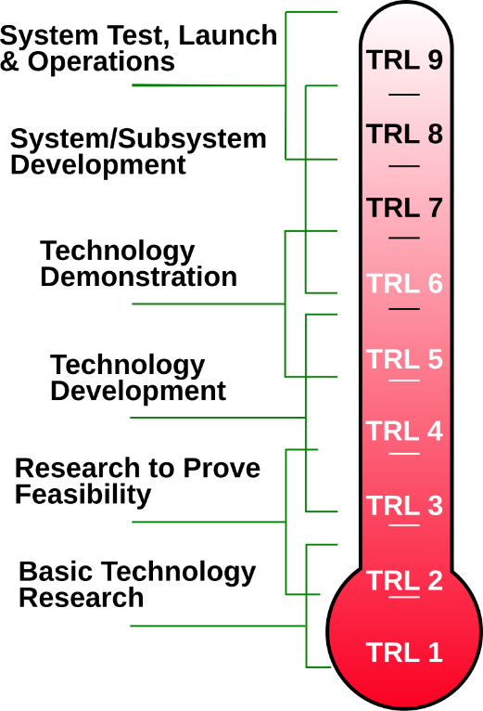
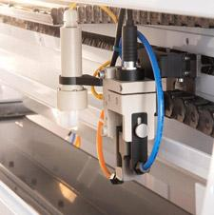
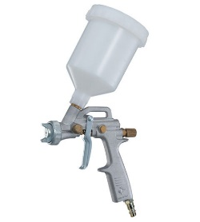


The Challenge (Why this matters)
  PGM-free electrodes on the basis of metal foams and especially nickel foams have been demonstrated to exhibit excellent performance.
  However, the activity and stability of these electrodes strongly depend on the uniformity and high quality of the coating process that is used to deposit and attach the catalyst on the substrate´s surface.
  Catalyst layers have to be permanently mechanically connected to the substrate across the whole surface area (i.e. without stresses to avoid delamination).
  This is a challenging task for the manufacturers of electrodes due to the electrodes´ large and increasing areas (of several square meters).
  A scalable and automatable coating process that can be adapted to the different materials systems used for OER and HER.
Visualisation of increasing size and uniformity requirements
© USI
© DF Tools
13/04/2026
LISPIE
https://de.wikipedia.org/wiki/Technology_Readiness_Level
2
Expected increase in TRL level

Slide 3
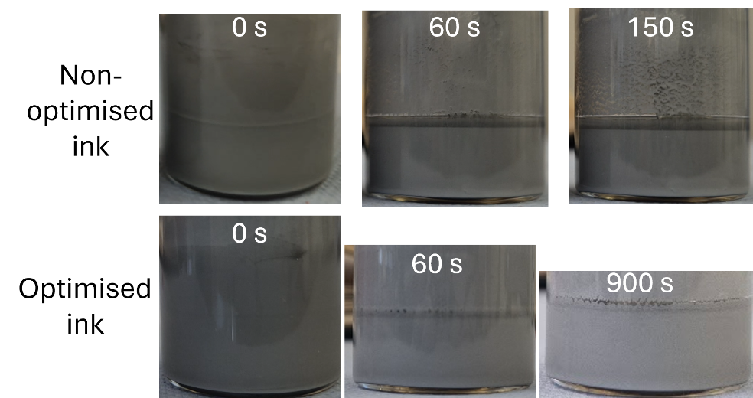

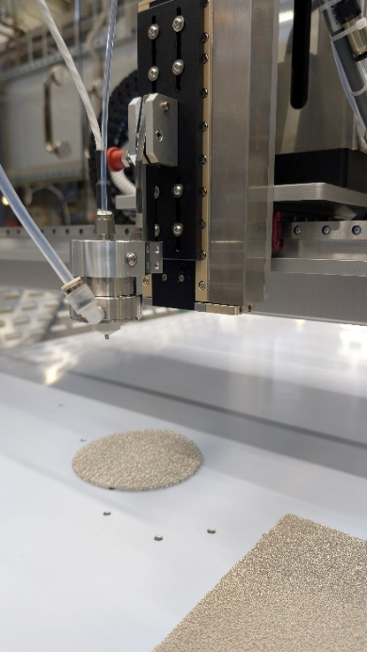
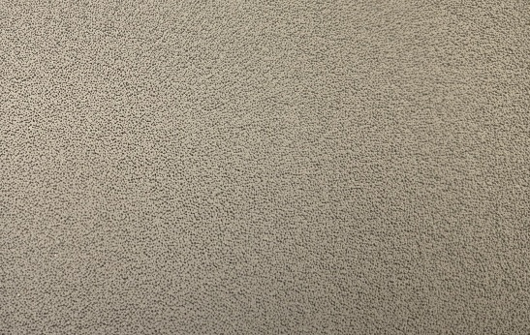
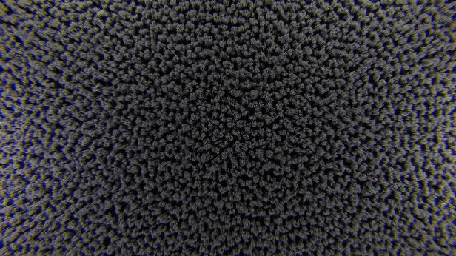
What we did (our solution)
  FHG IFAM has developed and sequentially optimised two ink formulations:
  An ethanol-based ink containing Al as the to-be-deposited species for the production of a Raney-Ni-like surface on a Ni cathode (HER), and
  An ethanol-based ink containing Ni and Fe particles for the generation of Ni-Fe-surfaces on a Ni anode (OER)
  The type of binder and stabilisers as well as their content in the ink were adapted for the automated spray coating procedure and the used air brush nozzle
  The inks were sprayed on Alantum-supplied Ni foam substrates, heat treated and analysed
  The electrochemical performance is evaluated in three-electrode arrangement
40 mm
10 mm
Ink optimisation (sedimentation test) as the basis for the automated spray coating process resulting in large-scale, uniformly coated samples (ethanol-based Al-containing ink shown)
13/04/2026
LISPIE
2

Slide 4
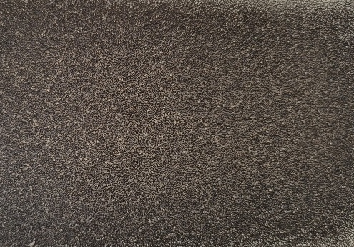
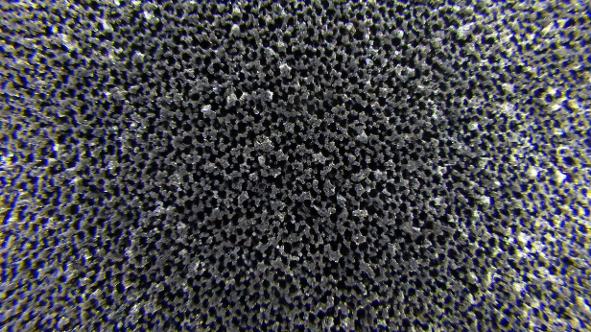
Obtained results (the impact)
  The large-scale Ni foams were successfully coated and showed uniform distribution of the deposited catalyst layer.
  As part of the analyses, the spray-coating process was optimized regarding the ink formulation, the spray parameters, the heat-treatment conditions and sample post processing.
  The cathodes (HER) were prepared using an ethanol-based ink containing fine Al particles to finally achieve a Raney-like Ni surface with high surface area (after heat treatment and post processing).
  The anodes (OER) were prepared using an ethanol-based ink containing Ni and Fe particles resulting in a highly active Ni-Fe surface layer.
+
spray coating
heat treatment of coated foam
40 mm
10 mm
Spray coating followed by heat treatment resulting in large-scale samples uniformly covered with black-brownish appearing nickel-aluminide phases
13/04/2026
LISPIE
3

Slide 5
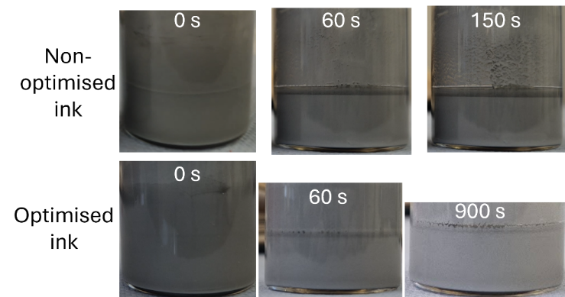
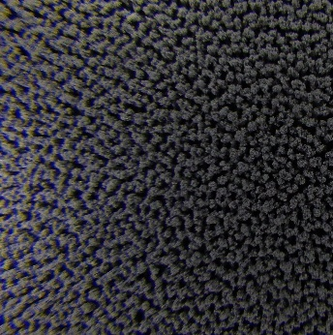
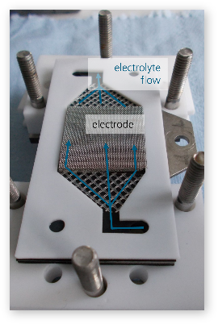
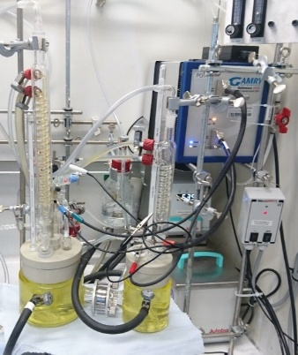
Conclusions
  A new scalable production technology for the uniform mass production of more efficient electrodes for AEL was developed and successfully applied.
  New inks on the basis of PGM-free electrocatalysts were produced and optimised for the spray coating process.
  For each particle-containing ink formulation (Al for Raney-like Ni, and Ni-Fe), a tailored heat treatment procedure was performed.
  The final electrodes exhibit excellent electrochemical performance.
  The more sustainable and environmentally friendly process chain represents an important step on the way from the laboratory and pilot plant R&D work to the actual implementation in the industrial production.
starting materials
Ni foam
(Alantum)
Suspension / Ink
spray coating
10 mm
heat treatment of coated foam
10 mm
final electrode
13/04/2026
LISPIE
5
Project summary
Electrochemical characterisation

Slide 6
LISPIE
Large-scale spray coating using innovative inks on different foam substrates for the production of highly efficient electrodes for AEL
Contact Information:
Anton Salomon (FHG IFAM DD): anton.christoph.salomon@ifam-dd.fraunhofer.de
Andreas Tillmann (Alantum Europe GmbH):
atillmann@alantum.com
This project has received funding from the European Union’s Horizon Europe research and innovation programme. Views and opinions expressed are however those of the author(s) only and do not necessarily reflect those of the European Union or the European Innovation Council and SMEs Executive Agency (EISMEA). Neither the European Union nor the granting authority can be held responsible for them

