Slide 1

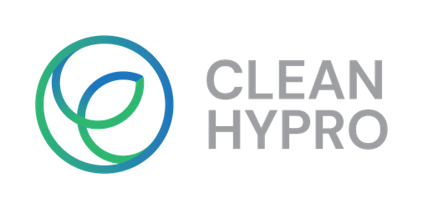

Testing low-cost electrolysis on real renewable power
Wind and solar power never hold still. Electrogenos builds low-cost, high-efficiency electrolyser stacks, and BTU Cottbus-Senftenberg is testing one against current profiles taken from real European wind and solar data — to show that cheap hydrogen can keep up with the weather.
CLEANHYPRO Democase · Electrogenos (UK) with BTU Cottbus-Senftenberg (DE)
This project has received funding from the European Union’s Horizon Europe research and innovation programme. Views and opinions expressed are however those of the author(s) only and do not necessarily reflect those of the European Union or the European Innovation Council and SMEs Executive Agency (EISMEA). Neither the European Union nor the granting authority can be held responsible for them

Slide 2
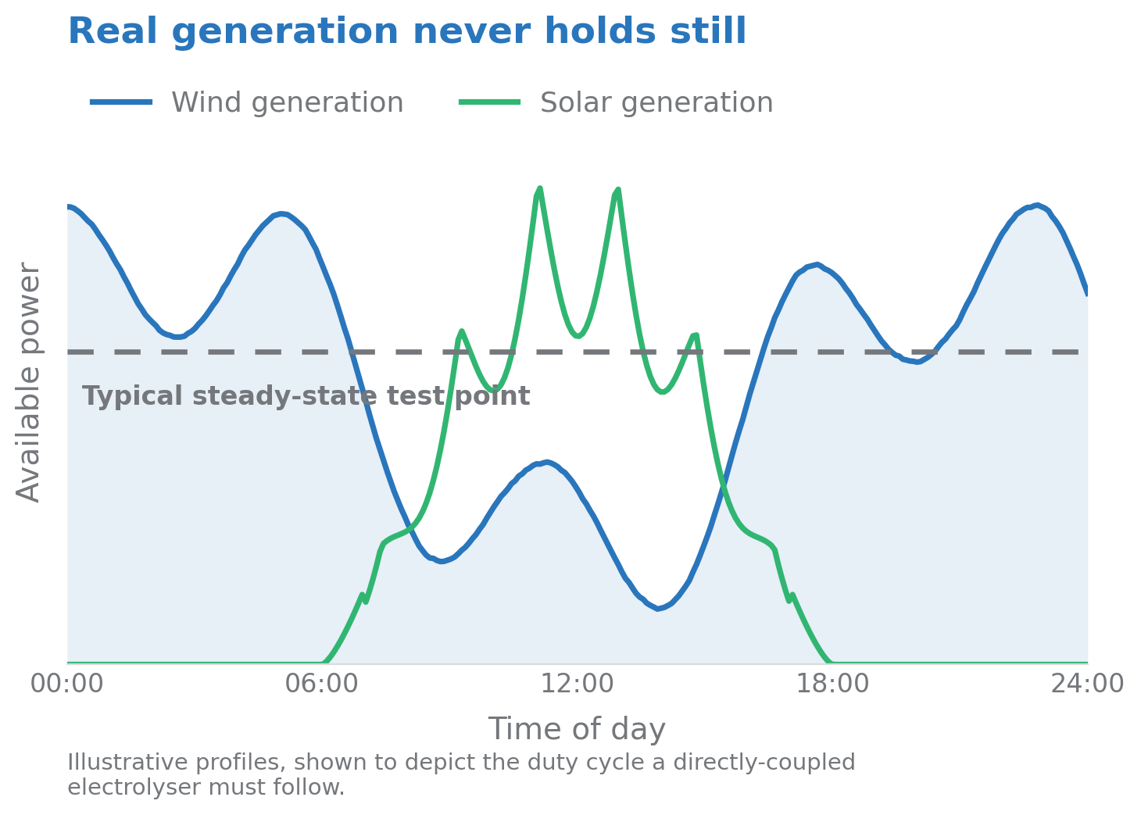

The challenge: why this matters
  Hydrogen is cheapest when it is made with wind and solar power — but that power swings by the minute.
  Electrolyser stacks are normally characterised at one steady operating point; a condition no directly-coupled renewable installation ever delivers.
  Load cycling is a major driver of stack degradation, and stack lifetime dominates the cost of the hydrogen produced.
  Electrogenos needed independent evidence of how its stack behaves under a realistic renewable duty cycle — and access to the rig and expertise to generate it.
14/08/2026
CLEANHYPRO Democase – Electrogenos
2

Slide 3
What we did: our solution
  Access. Through the CLEANHYPRO open call, Electrogenos gained access to the electrolysis test facilities of BTU Cottbus-Senftenberg, Chair of Thermal Energy Technology.
  Real duty cycles. Test profiles were built from measured European generation data (ENTSO-E Transparency Platform) for solar, onshore and offshore wind, scaled to the stack's operating envelope.
  Two-track programme. One stack follows a renewable generation profile; a second runs a standard accelerated stress test, so dynamic and conventional degradation can be compared.
  Independent assessment. Characterisation, cycling and analysis are performed by BTU researchers — not by the stack manufacturer.
14/08/2026
CLEANHYPRO Democase – Electrogenos
3

Slide 4
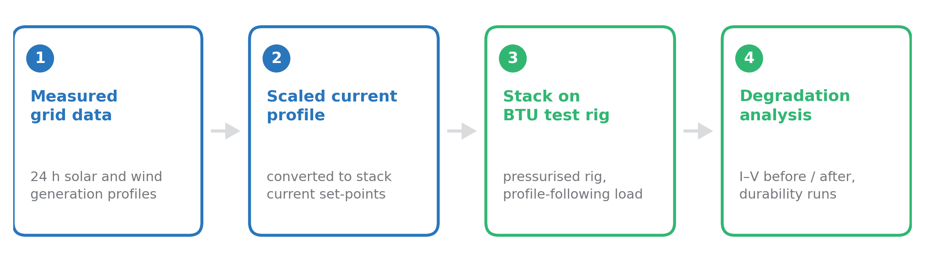
How the testing works
  Twenty-four-hour generation profiles are converted into stack current set-points and time-compressed, so a full day of renewable variability runs within one testing day.
  Wind-derived profiles come first — the steepest ramps — followed by solar profiles.
  Degradation is resolved by polarisation (I–V) curves before and after cycling, plus extended constant-current operation with continuous voltage monitoring.
14/08/2026
CLEANHYPRO Democase – Electrogenos
4

Slide 5
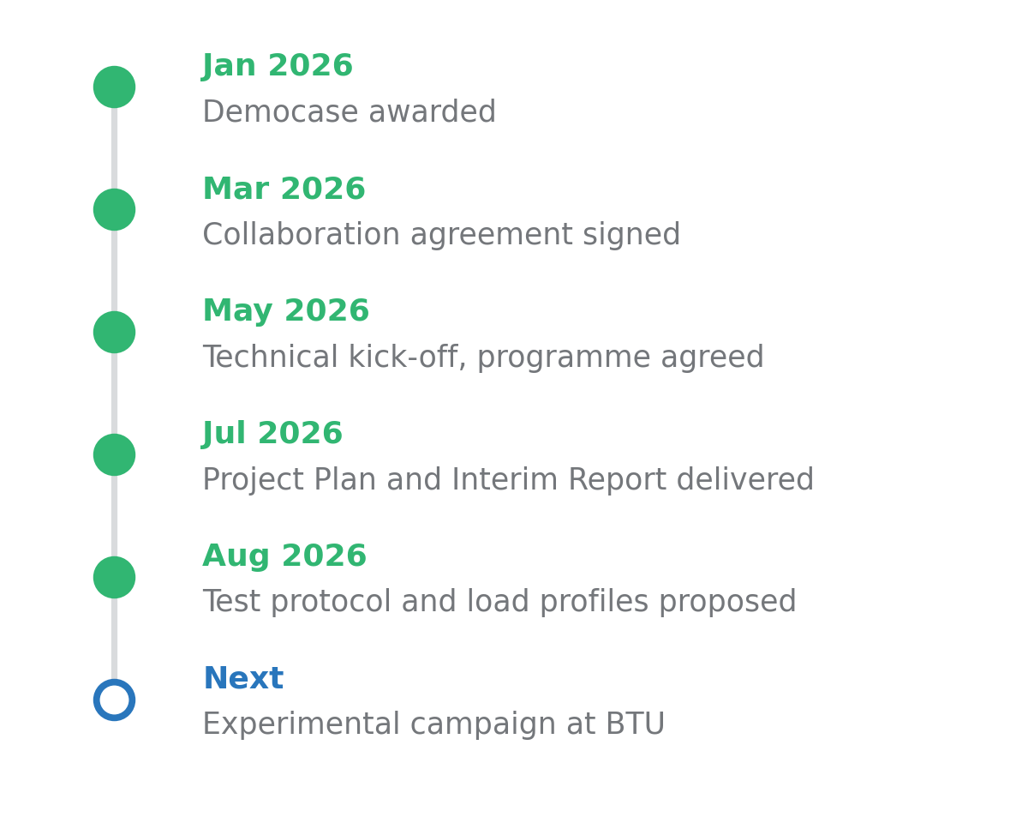
Progress to date and expected impact
  A detailed test protocol has been developed jointly by Electrogenos and BTU engineers — profile selection, cycle compression, characterisation sweeps and degradation criteria — and is in final review.
  Renewable current profiles have been generated from real grid data and scaled to the stack envelope.
  The experimental campaign at BTU follows stack delivery; measured performance and degradation rates will be reported in the final technical report.
  What the campaign sets out to show: stable operation across a wide load range under renewable-following duty, and a degradation rate quantified against steady operation.
14/08/2026
CLEANHYPRO Democase – Electrogenos
5

Slide 6
Conclusions
  What decides whether low-cost electrolysis delivers low-cost hydrogen is behaviour under dynamic operation — not efficiency at a single set-point.
  Building test profiles from measured grid data gives a far more honest picture of stack durability than a fixed operating point.
  Open-access infrastructure of the kind CLEANHYPRO provides lets a small company obtain independent, credible validation it could not build in-house.
  Low-cost stacks that can follow generation directly support Europe's green hydrogen goals, cutting both the capital and the electricity cost of producing hydrogen.
14/08/2026
CLEANHYPRO Democase – Electrogenos
6

Slide 7
Testing low-cost electrolysis on real renewable power
Contact
Augusto Bartolome · Co-founder & CTO, Electrogenos · augusto@electrogenos.com
Harshit Dhanani · BTU Cottbus-Senftenberg · harshit.dhanani@b-tu.de
This project has received funding from the European Union’s Horizon Europe research and innovation programme. Views and opinions expressed are however those of the author(s) only and do not necessarily reflect those of the European Union or the European Innovation Council and SMEs Executive Agency (EISMEA). Neither the European Union nor the granting authority can be held responsible for them

