Slide 1


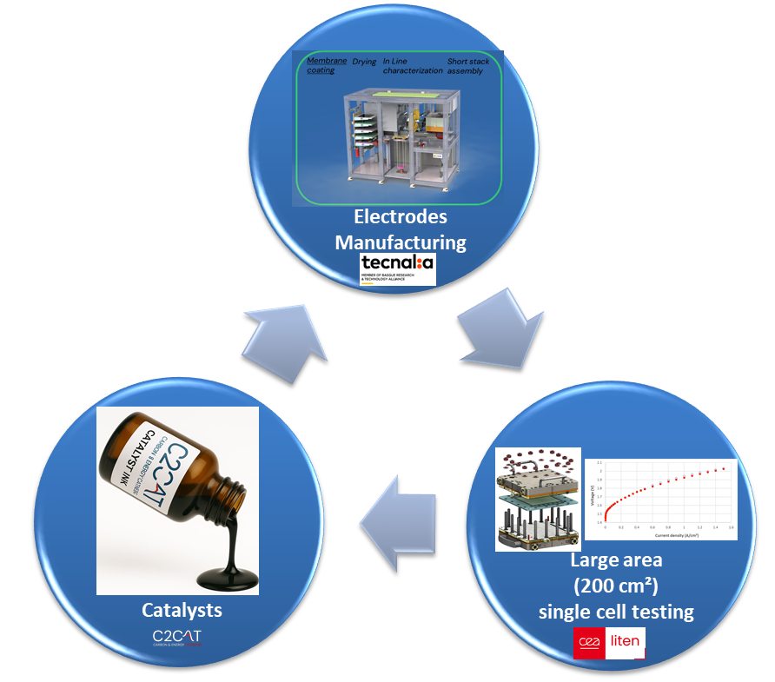

NanoMEA
NANOMEA aims to bring a catalyst supplier to automated electrodes manufacturing for AEMWE application. A consortium composed by C2CAT (small company in Holland), TECNALIA (RTO in Spain) and CEA (RTO in France) are joining their expertises in order provide advanced commercial electrodes for low cost and renewable hydrogen production.
Main Achievements
C2CAT electrodes investigated
1.85 V (80%_{HHV}) @ 1.5 A/cm² with Pt catalyst in 0.1 M KOH 80°C
Pt based C2CAT catalysts are as active as benchmark CEA materials for HER
Next Steps
Investigate non PGM catalyst as alternative Pt
Investigate the process method to automate the manufacturing process
To evaluate the as prepared electrode in a representative environment

Slide 2
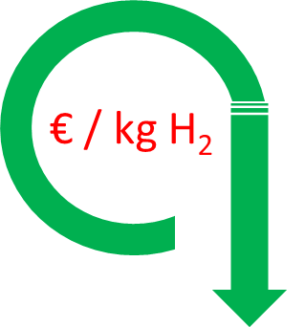

The Challenge (Why this matters)
Levers are :
Low cost raw material (non PGM catalyst)
Hydrogen cost reduction is the main driver
High performing electrodes
Automated electrodes manufacturing
Materials
Manufacturing
Testing
PGM Cathode materials need to be competitive with established catalyst suppliers.
Hand-made electrode preparation is time consuming and non-effective
OPEX is the most impactful driver cost to the hydrogen cost, the cell efficiency has to be high as possible.
Non PGM Cathode materials will decrease the stack cost significantly.
TECNALIA will manufacture electrodes using its Automated Catalyst-Coated Membrane (CCM) Manufacturing and Short Stack Assembly Line for Electrolysis
CEA will evaluate the large automated electrodes (200 cm²) in single-cell hardware.
CEA will address electrochemical characterizations for assessing alternative materials
kPI#1 : from 0.3 to 0.1 g of PGM/kW
kPI#2: from 10 min to 3 min per electrode
kPI #3: from 78 % (1.9V) to 80% (1.85 V) @ 1.5 A/cm²
15/08/2026
NanoMEA_AEMWE_Democase

Slide 3
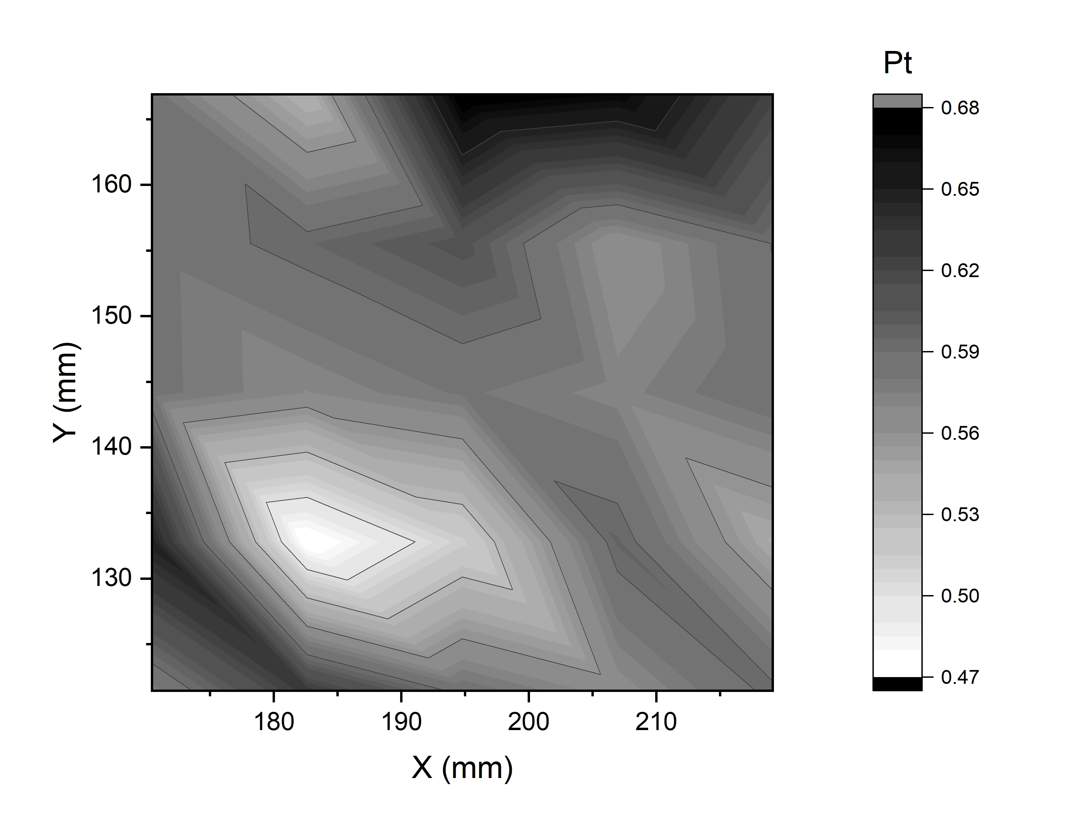
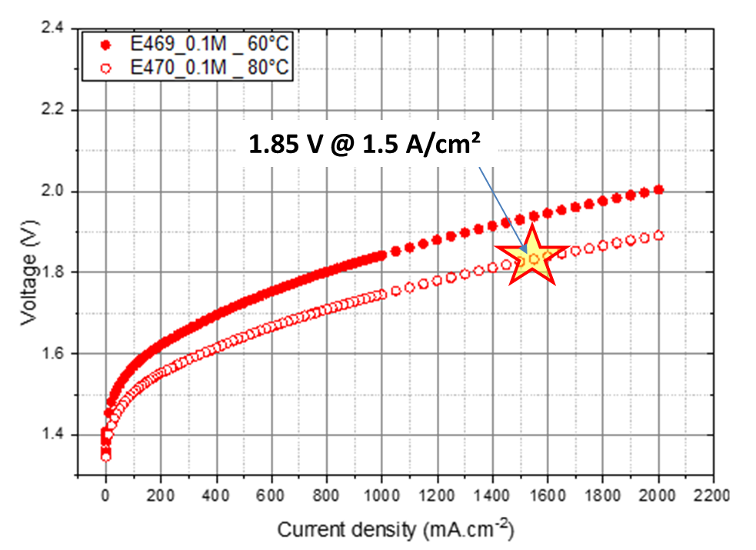
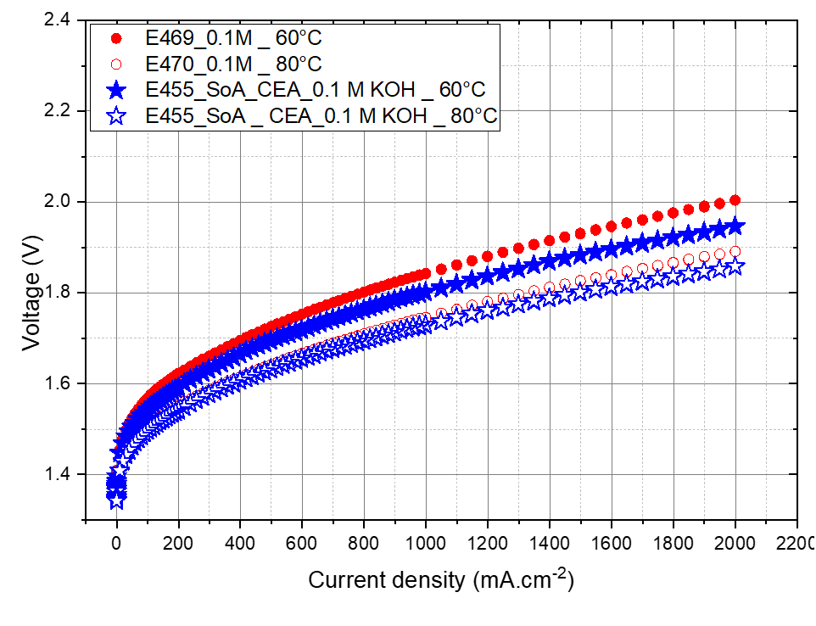
What we did (our solution)
Assessment of base materials before potential areas for improvement
MEA:
Ni alloy felt / PiperIon 60µm / C2CAT cathode (Pt based)
Cathode loading 0.3 mg/cm² selected area from XRF measurements)
Cell surface : 1.8 cm²
XRF Mapping
1.85 V @ 1.5 A/cm²
Expected Pt loading : 0.3 mg Pt/cm²
Actual loading : 0.582 +/- 0.1 mg Pt/cm² over 25 measurement points
Room for the improvement of the catalytic ink deposition.
kPI#1 is reached with 0.06 g/kW of PGM
kPI#3 is reached but with PGM catalyst (1.85 V @ 1.5 A/cm²)
C2CAT catalysts are as active as CEA benchmark
15/08/2026
NanoMEA_AEMWE_Democase
2

Slide 4

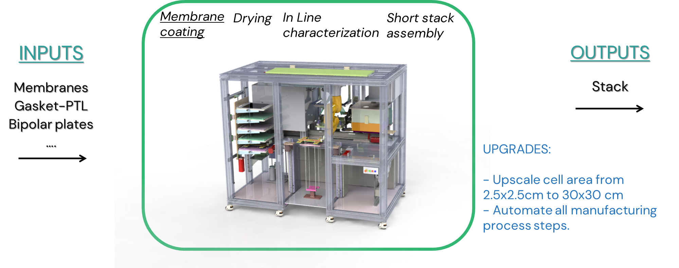
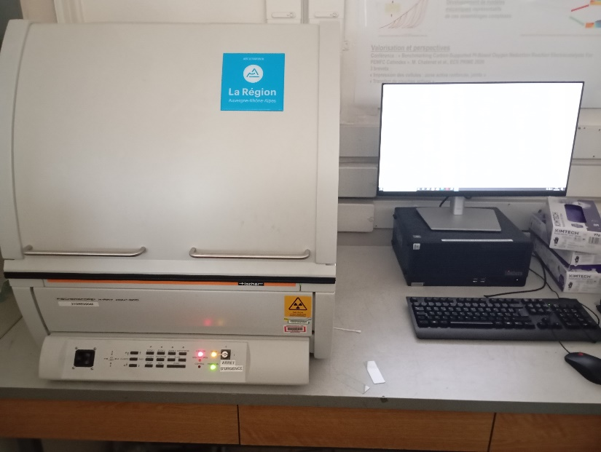
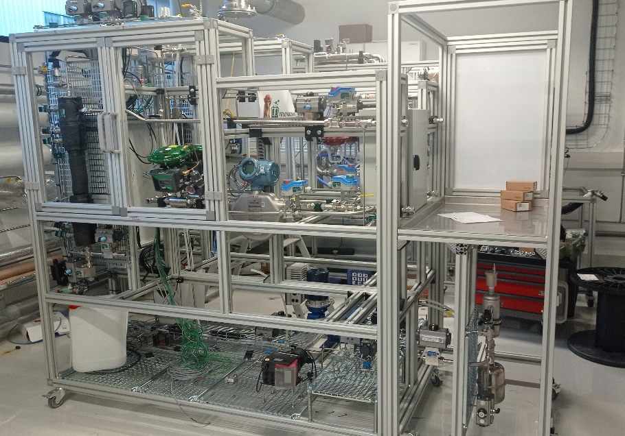
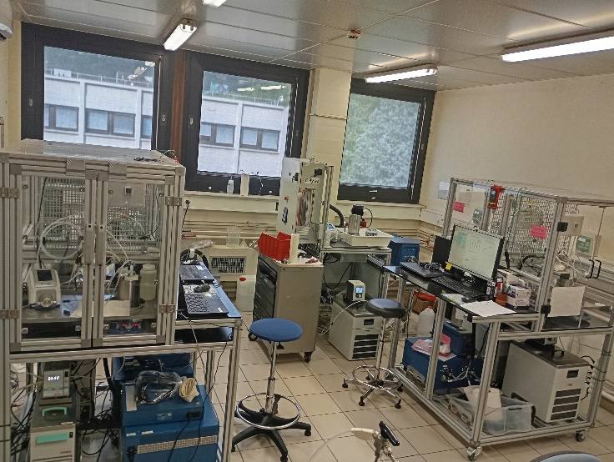
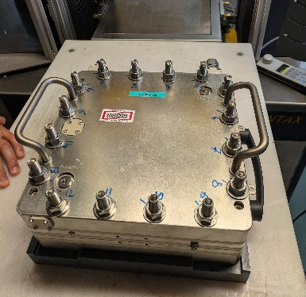
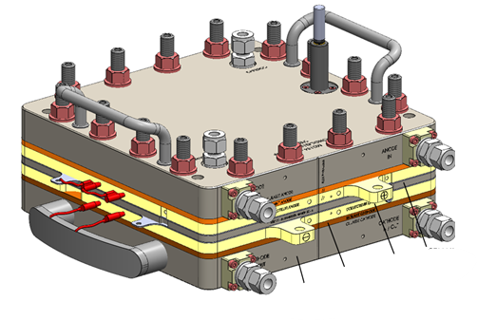
Techniques used (if more info is needed)
Short stack and large single cell test bench
Automated electrode fabrication
XRF equipment for the mapping of the catalyst loading
4
15/08/2026
NanoMEA_AEMWE_Democase
Test bench for small scale MEA testing

Slide 5
Obtained results (the impact)
Pt based C2CAT catalyst is as active as the commercial benchmark PGM HER catalyst
1.85 V@1.5 A/cm² with Pt catalyst in 0.1M KOH 80°C (kPI# 1 and kPI#3 reached)
Investigations on non PGM catalyst ongoing
Investigations alternatives ink composition and rheology ongoing
Not started yet
Not started yet
15/08/2026
NanoMEA_AEMWE_Democase
3

Slide 6
Conclusions
NanoMEA is a collaborative project in order to bring a new products to a small company that deals with hydrogen technology.
CLEANHYPRO partners share their expertises in electrochemical testing and electrode manufacturing to assist C2CAT in providing stable and active large size electrodes.
Preliminaries investigations have shown high activity of the Pt based electrode for HER but not homogeneous ink coating.
Next steps will be dedicated to investigate non PGM catalyst and alternative ink formulation to improve the cell efficiency.
Ink rheology and automated ink coating will be also investigated.
15/08/2026
NanoMEA_AEMWE_Democase
5

Slide 7
Democase NanoMEA
Contact Information: Frederic FOUDA-ONANA
frederic.fouda-onana@cea.fr
This project has received funding from the European Union’s Horizon Europe research and innovation programme. Views and opinions expressed are however those of the author(s) only and do not necessarily reflect those of the European Union or the European Innovation Council and SMEs Executive Agency (EISMEA). Neither the European Union nor the granting authority can be held responsible for them

