Slide 1


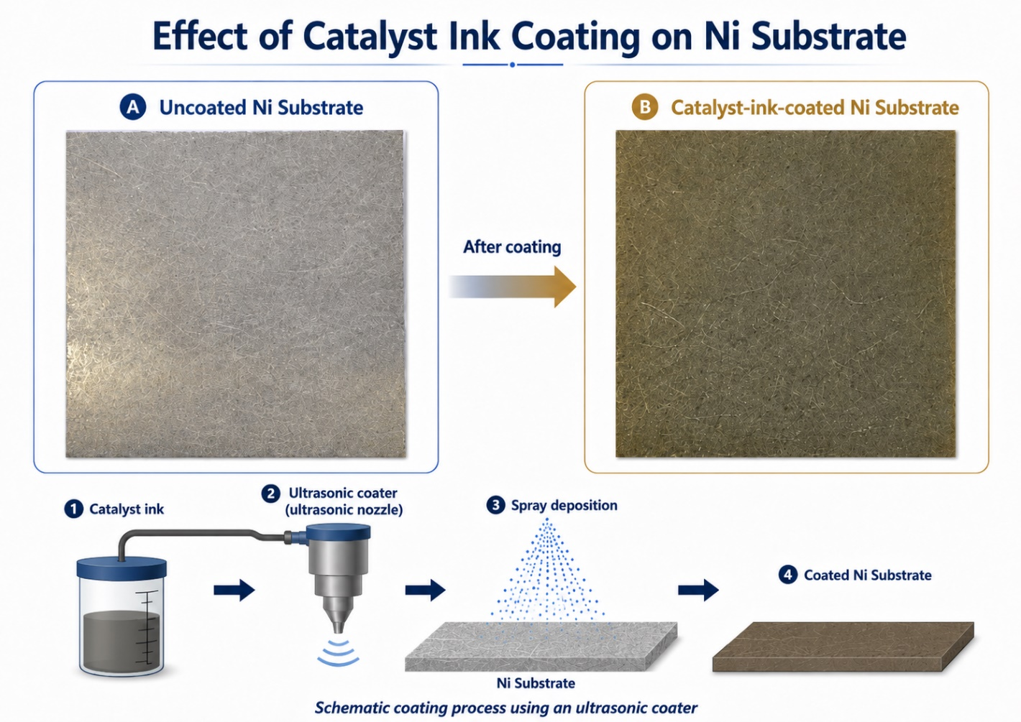

THINK
The primary objective of this project is to develop a new generation of high-performance, ultra-robust electrodes for Alkaline Water Electrolysis (AEL) and Anion Exchange Membrane (AEM) electrolysis.
Matteco’s catalyst ink was successfully coated onto Ni substrates at various loading levels. The subsequent post-treatment met Matteco’s benchmark (OER performance). Furthermore, a coating process offering greater long-term stability was developed and the process window was defined!
Fig.: Presentation of the spray deposition process.
This project has received funding from the European Union’s Horizon Europe research and innovation programme. Views and opinions expressed are however those of the author(s) only and do not necessarily reflect those of the European Union or the European Innovation Council and SMEs Executive Agency (EISMEA). Neither the European Union nor the granting authority can be held responsible for them

Slide 2
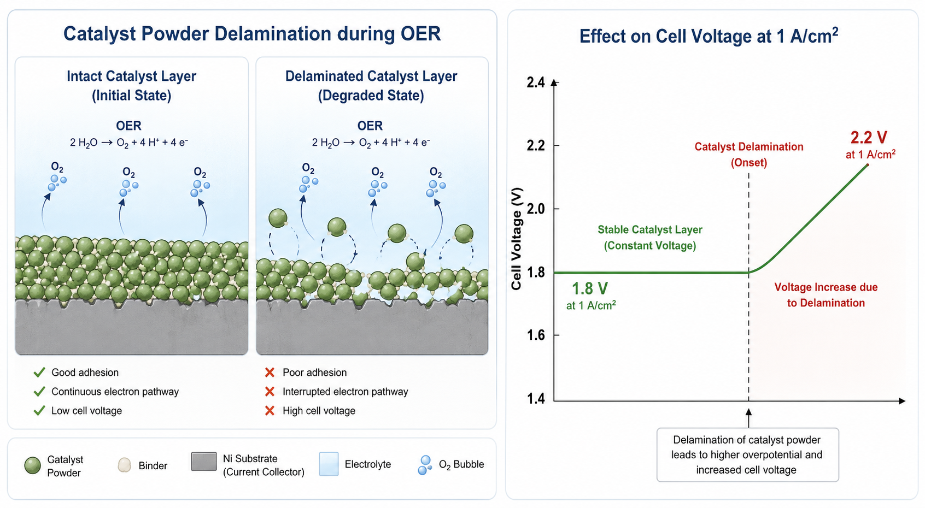

The Challenge (Why this matters)
  Current state-of-the-art electrodes often rely on traditional thermal sprayed Raney-Nickel or electrodeposited active outer layers on nickel-based substrates. While functional, these layers frequently suffer from delamination under the dynamic loads typical of renewable energy integration (Solar/Wind) and/or harsh alkaline environments.
  The solution of this problem lies in developing a catalyst architecture that remains stable both in the harsh KOH liquid environment at AWE and under the high demands placed on current density and cycle life at AEM. To achieve this, the aim is to enable a more stable bonding of the catalyst to the substrate by means of heat treatment.
Fig.: Presentation of motivation of Think project: Preventing of delamination process of catalyst.
13/04/2026
Think
2

Slide 3
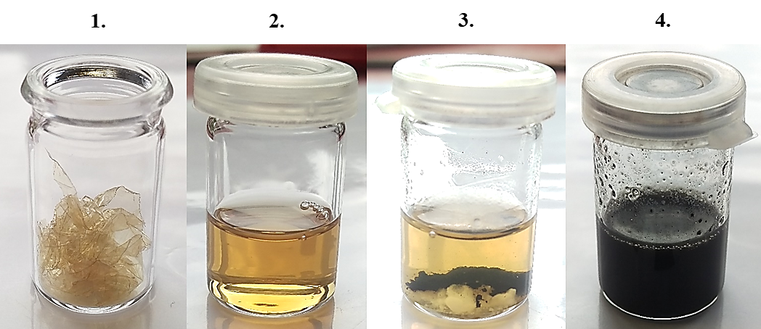
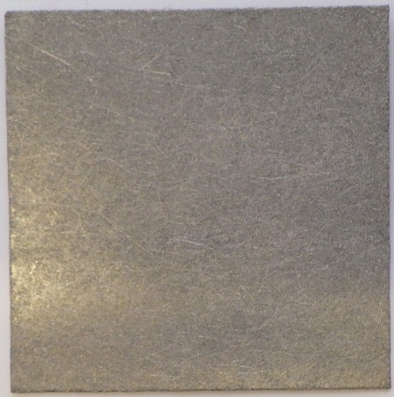
What we did (our solution)
  Matteco has produced and optimized different metal-containing polymer binders regarding their rheological properties.
  Fh IFAM has spray-coated different Ni felts with different polymer binders and different loadings.
  Different processing conditions were evaluated to identify those providing improved adhesion of the metal coating to the felt.
  The coated electrodes were analyzed electrochemically in the Three-Electrode-Arrangement regarding OER activity.
Fig.: Used polymer-binders, Ni felt and the used coating system.
13/04/2026
Think
2

Slide 4
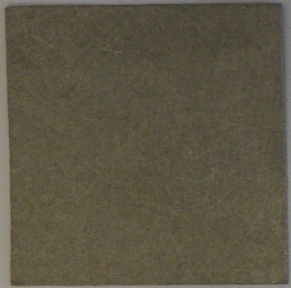
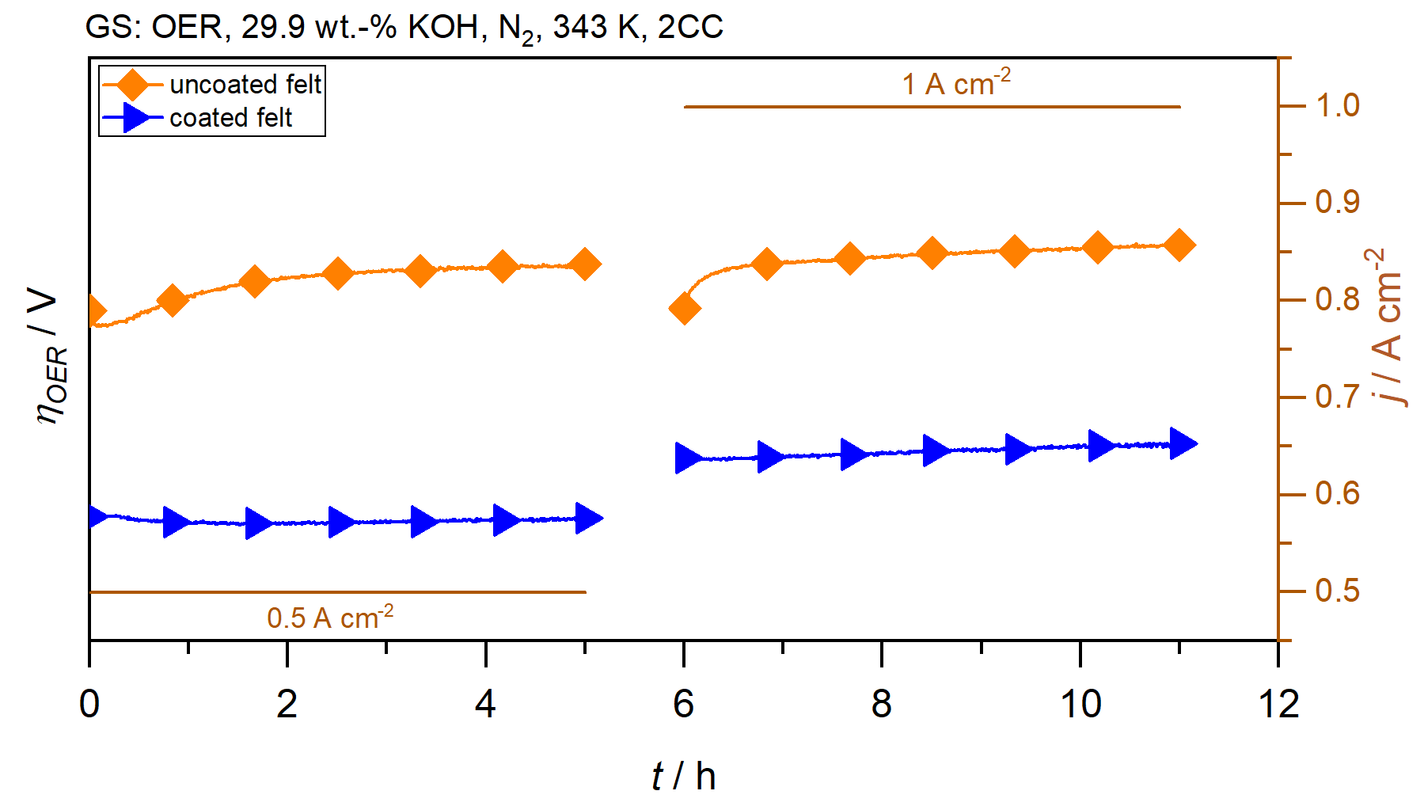
Obtained results (the impact)
  The successful coating of the Ni felt with the metal-containing polymer binder was evident from the macro images.
  The electrochemical analysis of the metal coated Ni felt shows that the OER overpotential of the coated sample is more than 100 mV lower than that of the uncoated sample. It can therefore be concluded that this successful coating has improved OER activity.
  As part of these analyses, the spray-coating process was optimized regarding heat-treatment and loading.
Fig.: Macro images of the uncoated Ni felt and metal-coated Ni felt.
Fig.: OER overpotential-time curve of uncoated and of coated Ni felt.
13/04/2026
Think
3

Slide 5
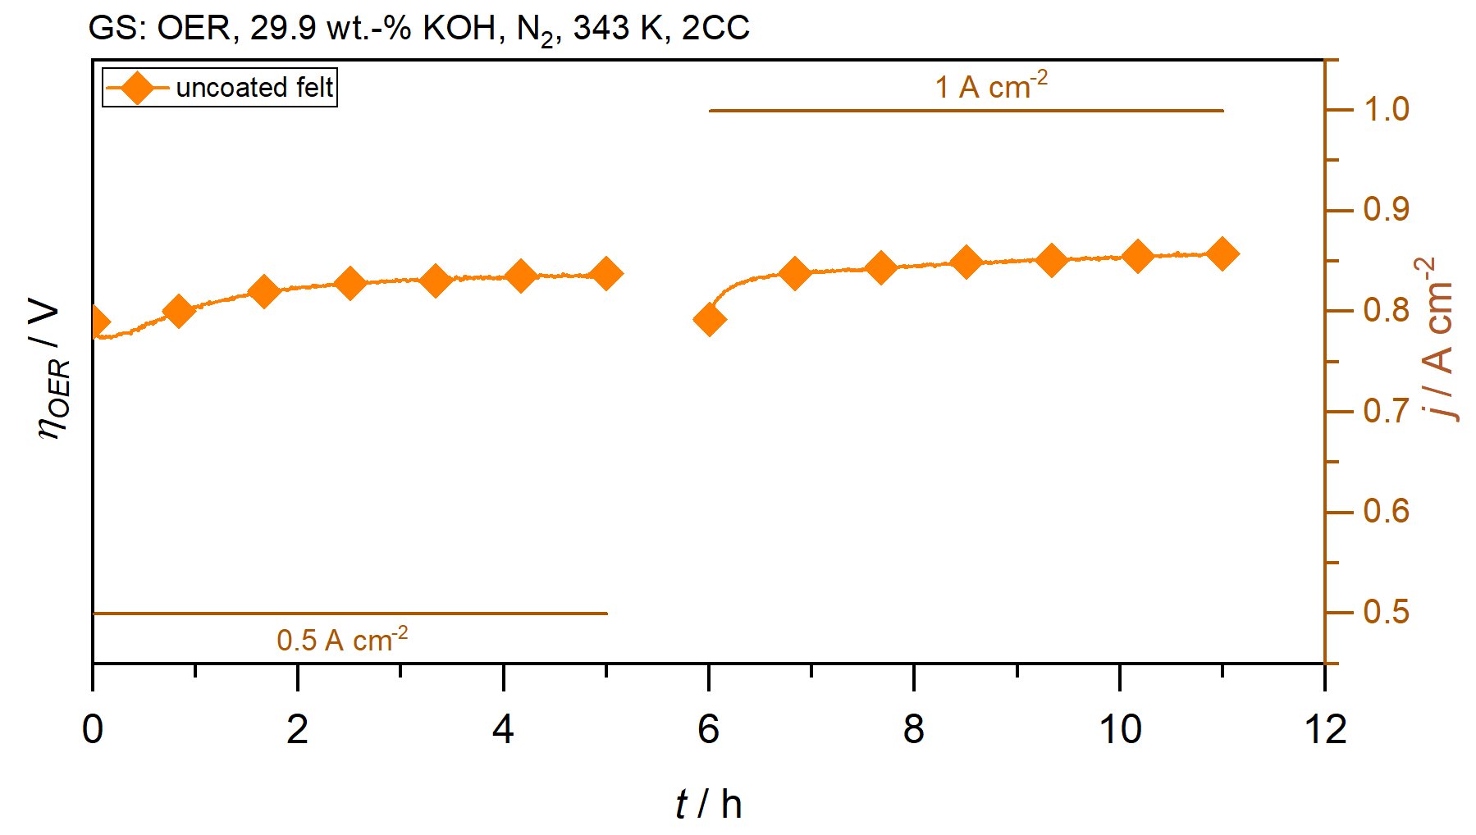
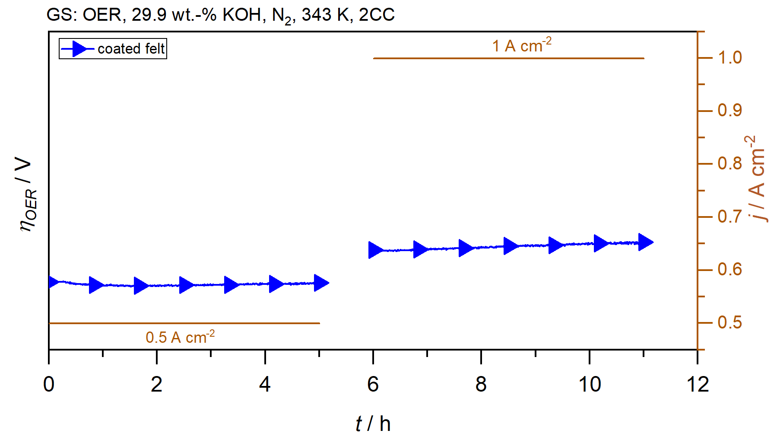
Conclusions
  Matteco and Fh IFAM has developed successfully a scalable coating process of Ni felts with a metal containing polymer binder.
  The stable OER overpotential of the coated felt is more than 100 mV lower than that of the uncoated sample. It can be concluded that the coating leads to an improved OER activity.
  The development of a long-term stable, high active and scalable anode route reduces significantly the OPEX cost of industrial alkaline electrolysers.
Fig.: Summary of Think project: Successful coating of Ni felt with metal containg polymer binder which leads to a significant increasing OER activity of the coated Ni felt.
13/04/2026
Think
5

Slide 6
Thermal treatment of catalyst coated substrates made of advanced INKs to manufacture robust electrodes for alkaline-based water electrolysis stacks
THINK
Contact Information:
Dr. rer. nat. Christian Immanuel Bernäcker
mailto: christian.bernaecker@ifam-dd.fraunhofer.de
Fraunhofer Institute for Manufacturing Technology and
Advanced Materials IFAM, Dresden Branch
Winterbergstrasse 28 | 01277 Dresden | Germany
This project has received funding from the European Union’s Horizon Europe research and innovation programme. Views and opinions expressed are however those of the author(s) only and do not necessarily reflect those of the European Union or the European Innovation Council and SMEs Executive Agency (EISMEA). Neither the European Union nor the granting authority can be held responsible for them

