Slide 1


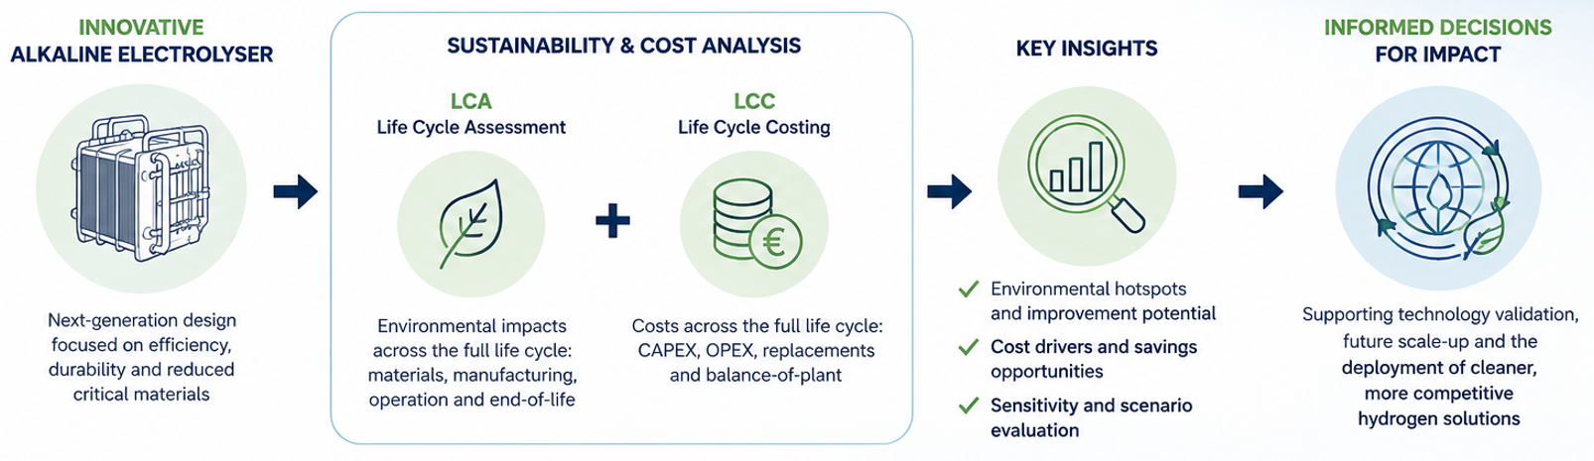

ALCA: Sustainability and Cost Assessment of an Innovative Alkaline Electrolyser
A new electrolyser can only make an impact if its environmental and economic benefits are clear.
This demo case combines LCA and LCC to assess a next-generation alkaline electrolyser.
The analysis will help identify its sustainability potential and support future scale-up decisions.
This project has received funding from the European Union’s Horizon Europe research and innovation programme. Views and opinions expressed are however those of the author(s) only and do not necessarily reflect those of the European Union or the European Innovation Council and SMEs Executive Agency (EISMEA). Neither the European Union nor the granting authority can be held responsible for them

Slide 2
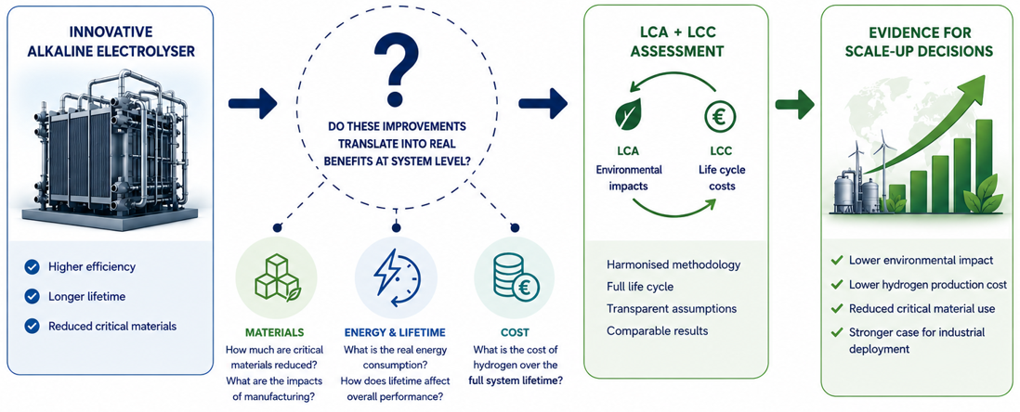

The Challenge (Why this matters)
  Advanced alkaline electrolysers can improve efficiency, lifetime and material use, but these benefits are not always easy to quantify at system level.
    The key challenge is to understand whether technological improvements actually lead to:
    Lower environmental impacts across manufacturing, operation and end-of-life.
    Lower hydrogen production costs over the full system lifetime.
    Reduced dependence on critical raw materials and improved resource efficiency.
    Better performance at industrial scale, not only at laboratory or prototype level.
  A harmonised LCA + LCC assessment is therefore needed to turn technical improvements into clear environmental and economic evidence.
11/08/2026
ALCA demo case
2

Slide 3
What we did (our solution)
LCA + LCC assessment of an innovative alkaline electrolyser
LCA: environmental impacts across the full life cycle.
LCC: costs, lifetime and hydrogen production cost.
Scenario analysis: comparison with a reference system and scale-up evaluation.
What is innovative?
A single, harmonised framework combining environmental + economic performance to support technology validation and scale-up decisions.
11/08/2026
ALCA demo case
2

Slide 4
Obtained results (the impact)
Main message:
The studied innovative prototype shows a lower environmental impact than the baseline system for the production of 1 kg H₂.
Top 3 results
Lower overall impact
This electrolyser performs better than the baseline across the assessed impact categories.
Improved operational efficiency
Lower electricity consumption per kg H₂ reduces operation-related impacts.
Clear design improvement path
Remaining hotspots are mainly linked to stack manufacturing, especially material-intensive components.
The Innovative electrolyser prototype demonstrates improved environmental performance mainly through lower operational electricity demand, while future gains should focus on stack material optimisation.
11/08/2026
ALCA demo case
3

Slide 5
Conclusions
Conclusions
The demo case provides a robust environmental and economic assessment of an innovative alkaline electrolyser.
The combined LCA + LCC approach helps identify where the technology can deliver the greatest sustainability and cost benefits.
The results will support technology validation, scale-up and better investment decisions for future hydrogen systems.
Contribution to European green hydrogen goals
By providing clear evidence on environmental performance, cost and scale-up potential, this work supports the development of more sustainable, competitive and resource-efficient electrolysers, helping accelerate the deployment of green hydrogen in Europe.
11/08/2026
ALCA demo case
5

Slide 6
ALCA: Sustainability and Cost Assessment of an Innovative Alkaline Electrolyser
Contact Information:
Jorge Arnal, TECNALIA
jorge.arnal@tecnalia.com
This project has received funding from the European Union’s Horizon Europe research and innovation programme. Views and opinions expressed are however those of the author(s) only and do not necessarily reflect those of the European Union or the European Innovation Council and SMEs Executive Agency (EISMEA). Neither the European Union nor the granting authority can be held responsible for them

