Slide 1


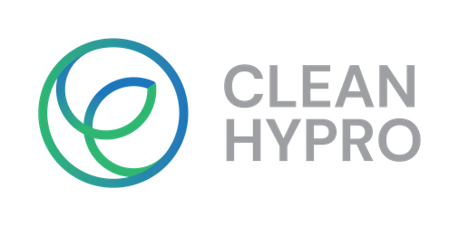

Durability Comparison AEM Water Electrolyser PTLs
Advancing durable components for green hydrogen production
Green hydrogen is expected to play an important role in Europe’s transition to a low-carbon economy.
Within CLEANHYPRO, partners evaluated innovative porous transport layer materials for Anion Exchange Membrane (AEM) water electrolysers.
The work enhanced understanding of material behaviour and supports the development of more reliable and cost-effective hydrogen production technologies.
​
This project has received funding from the European Union’s Horizon Europe research and innovation programme. Views and opinions expressed are however, those of the author(s) only and do not necessarily reflect those of the European Union or the European Innovation Council and SMEs Executive Agency (EISMEA). Neither the European Union nor the granting authority can be held responsible for them.

Slide 2

Why durable electrolyser components matter
Green hydrogen production relies on electrolysers that can operate efficiently and reliably over long periods. A key challenge is ensuring that internal components remain stable while exposed to demanding alkaline environments.
The consortium investigated advanced PTL concepts designed for AEM water electrolysers. The work included material characterisation, chemical stability assessment, electrochemical evaluation, and comparison of alternative material concepts.​
Improving the lifetime and reliability of critical components can help reduce maintenance needs, support lower system costs, and accelerate wider adoption of green hydrogen technologies.​
2

Slide 3
A combination of material, durability and electrochemical assessments was performed
Material characterization
Chemical stability assessment
Electrochemical evaluation​
In this work, 3 Porous Transport Layers (PTLs) composed of fibers with different material compositions were evaluated and compared. The objective was to identify the PTL design most suitable for AEM water electrolysis by assessing the relationship between chemical stability, electrochemical activity, and durability
A 500-hour ex-situ stress test in a highly alkaline environment assessed chemical stability. Mass loss, ICP analysis of dissolved species, and SEM/SEM-EDS imaging gave crucial insights on degradation levels and compositional changes for each PTL.
Electrochemical performance was assessed through two complementary approaches.
A three-electrode cell (LSV, EIS, galvanostatic measurements) captured the intrinsic activity of each PTL material.
An AEM single-cell configuration then added polarization curves, EIS, and a 24-hour durability test under real-life operating conditions.
The project combined complementary tests to build confidence in future PTL development​
2

Slide 4
Obtained results
Evaluated multiple PTL concepts​
Generated stability, electrochemical performance and durability insights
Contributed to AEM electrolysis component development
Improved understanding
Generated knowledge on how PTL materials behave under challenging conditions relevant to hydrogen production.
Promising development route
Compared alternative material concepts and identified learning points for future optimization.
Built a stronger knowledge base for more reliable, efficient and sustainable hydrogen production technologies.
Support for scale-up
3

Slide 5
Conclusions
Contribution to Europe’s green hydrogen goals
CLEANHYPRO demonstrated the importance of collaborative research in advancing materials for hydrogen production technologies.
Through characterization, durability investigations and electrochemical evaluation, the project generated valuable knowledge to support future AEM electrolyser development.
Better understanding of design attributes and limitations of the critical components helps create more robust, scalable and sustainable green hydrogen systems.
Supporting clean energy transition
Advancing hydrogen production technology
Strengthening European industrial innovation
Enabling more sustainable energy solutions
5

Slide 6
Durability Comparison AEM Water Electrolyser PTLs
Contact Information: Nazanin.Rashidi@bekaert.com
This project has received funding from the European Union’s Horizon Europe research and innovation programme. Views and opinions expressed are however, those of the author(s) only and do not necessarily reflect those of the European Union or the European Innovation Council and SMEs Executive Agency (EISMEA). Neither the European Union nor the granting authority can be held responsible for them.

